Slide 1
LAB 1
Made for Professor Lanham A. by Amrit Singh

Slide 2
AGENDA
Accessing the AWS management console
Task 1 : Launch Your Amazon EC2 Instance
Task 2 : Monitor Your Instance
Task 3 : Update Your Security Group and Access the Web Server
Task 4: Resize Your Instance: Instance Type and EBS Volume
Task 5: Resize Your Instance: Instance Type and EBS Volume
Task 6: Test Termination Protection

Slide 3
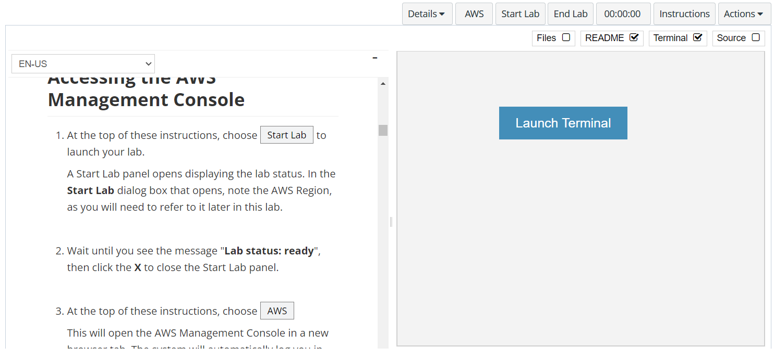
In aws labs click on start lab

Slide 4
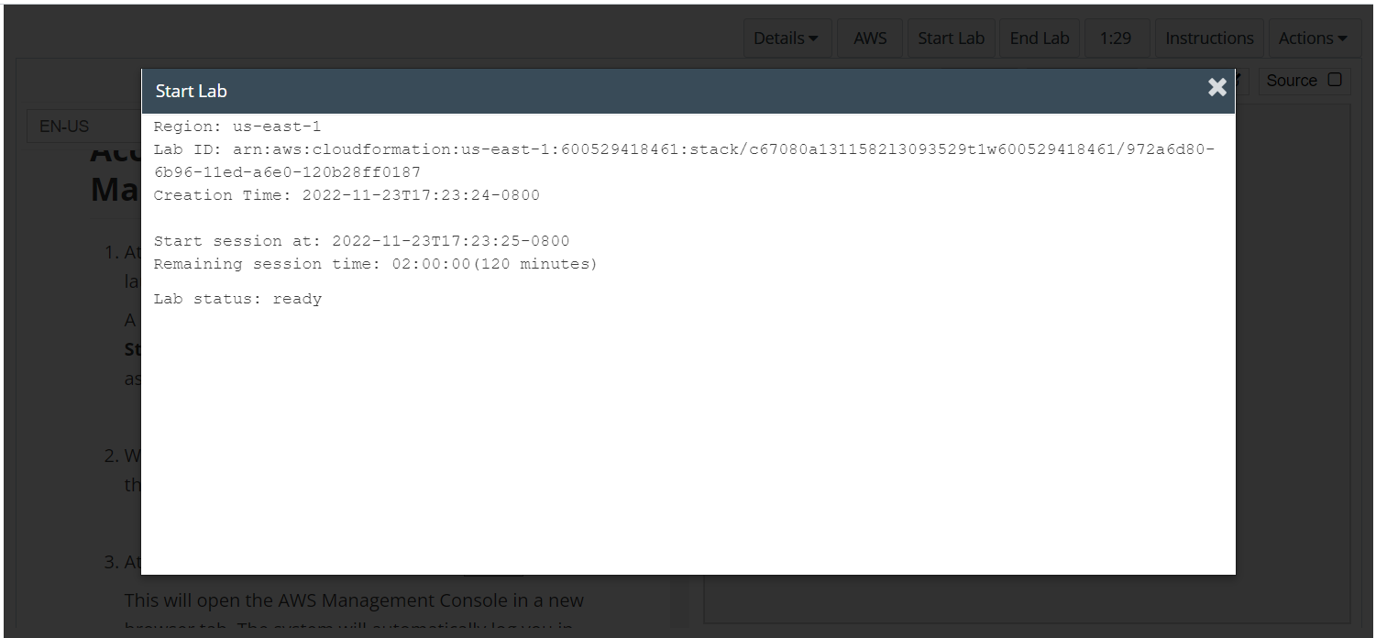
Wait to see lab ready status in the window then press x and click on aws to launch console

Slide 5
Task 1 : Launch Your Amazon EC2 Instance

Slide 6
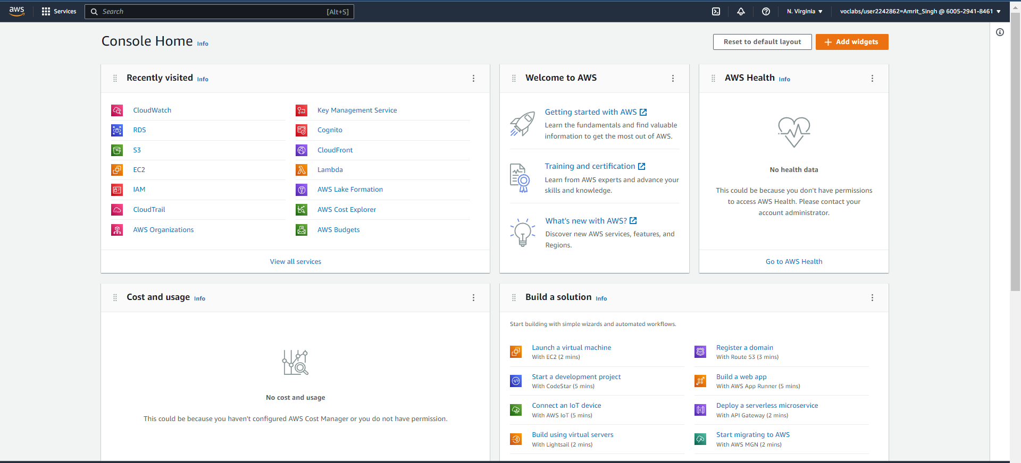
Homepage of the console

Slide 7
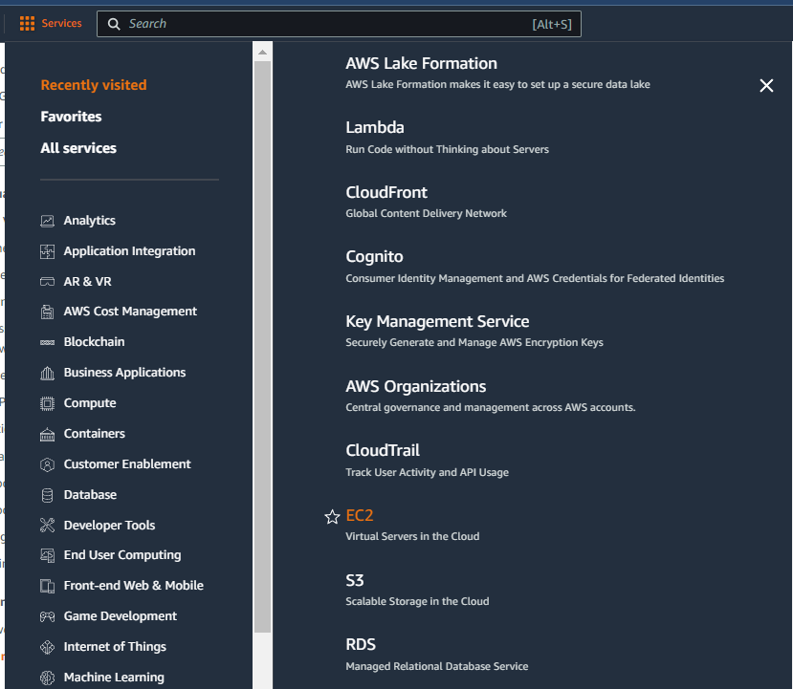
In the services menu select ec2

Slide 8
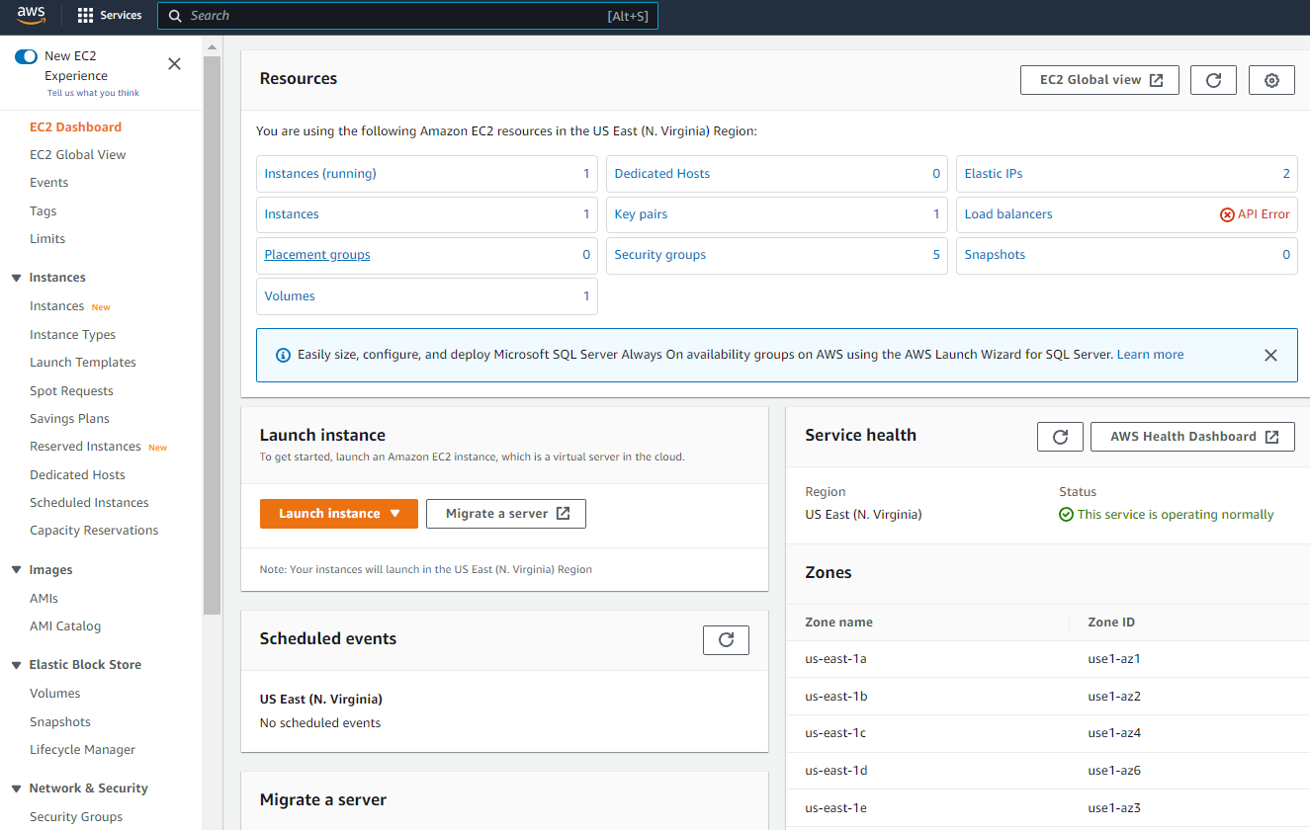
Click on launch instance in ec2 dashboard
Click on launch instance

Slide 9
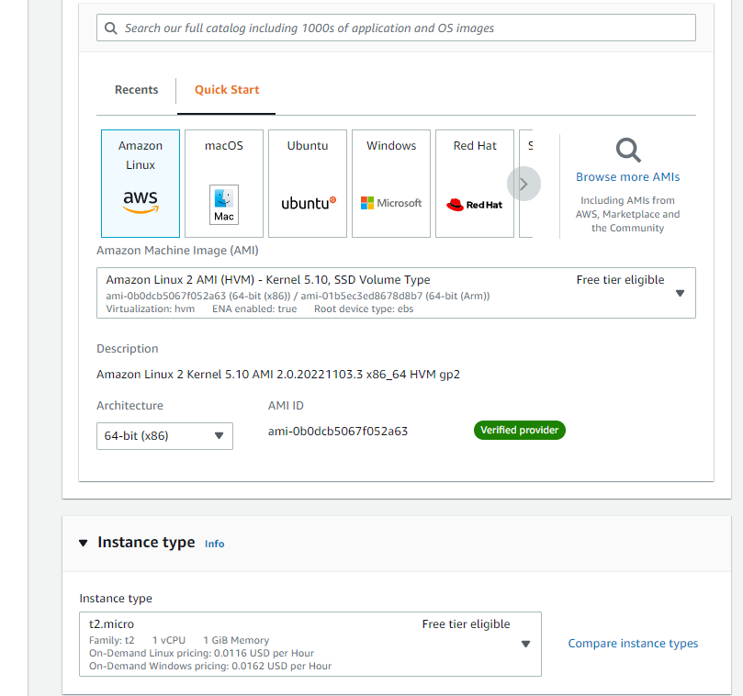
In the quick start menu choose amazon linux as the ami and update the settings based as per aws labs, set the instance type as t2.micro

Slide 10
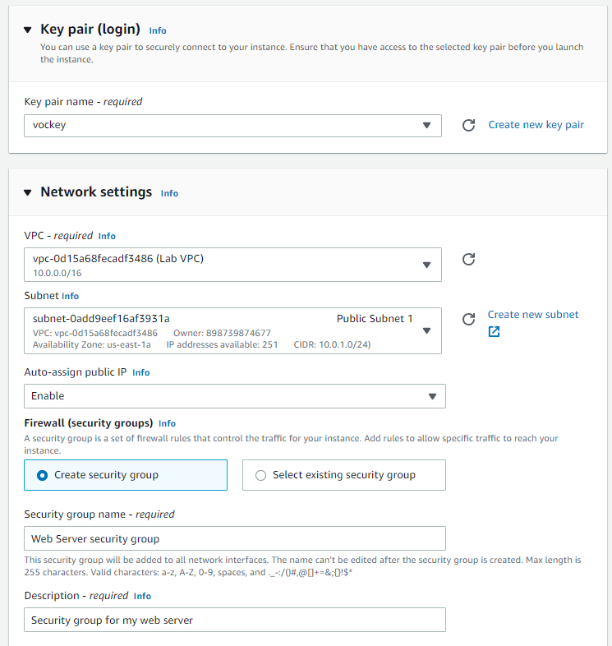
Set the key pair name to vockey and update the network settings as depicted

Slide 11
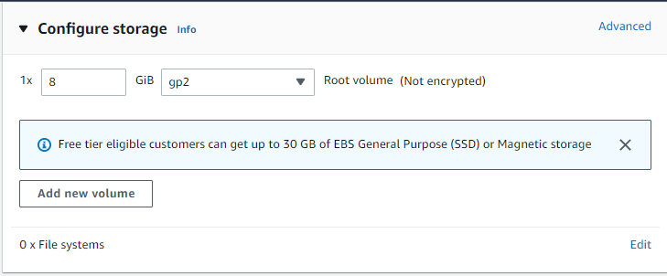
Keep the storage settings as default

Slide 12
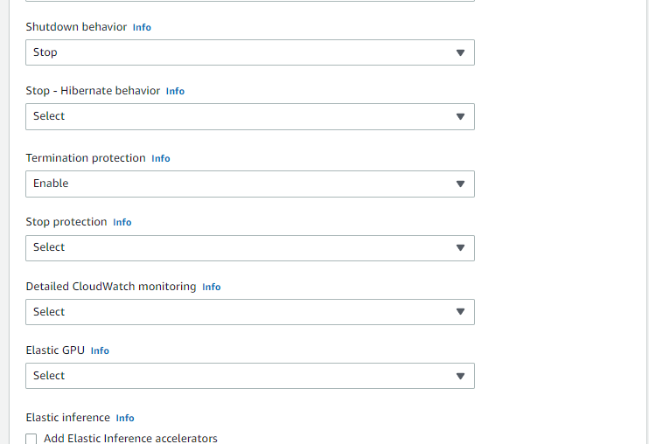
Under advanced settings enable termination protection

Slide 13
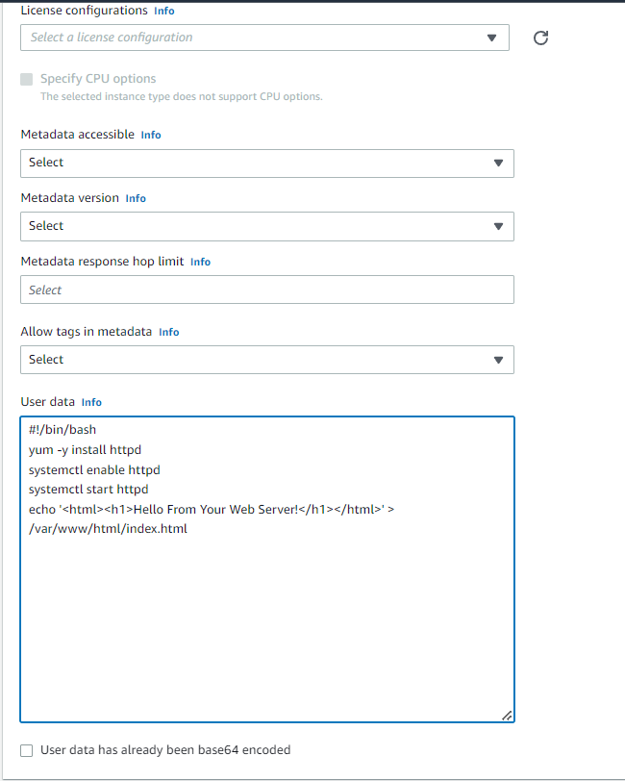
Add user data at the end of the advanced details page and click on create instance

Slide 14
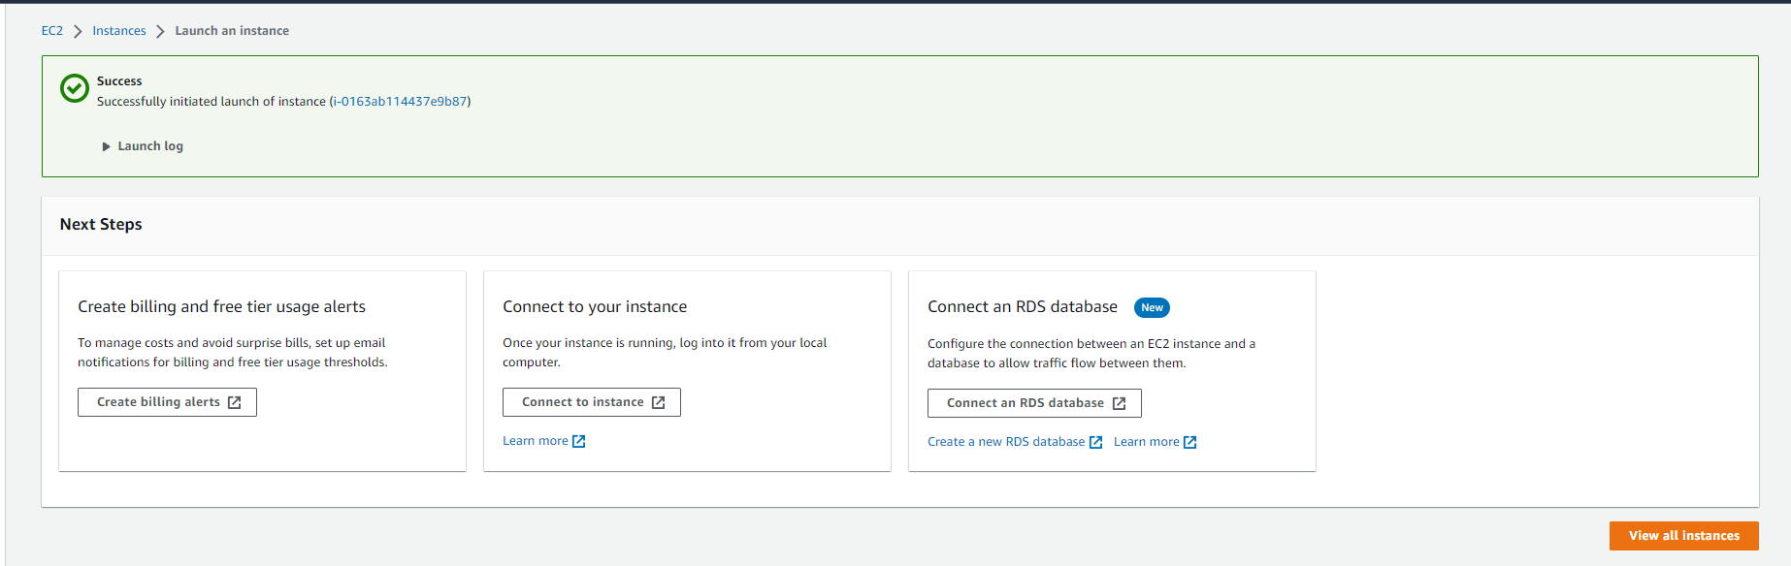
Ec2 instance created successfully, choose view all instances

Slide 15
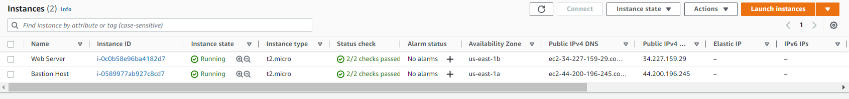
Wait for instance to pass checks

Slide 16
Task 2 :Monitor Your Instance

Slide 17
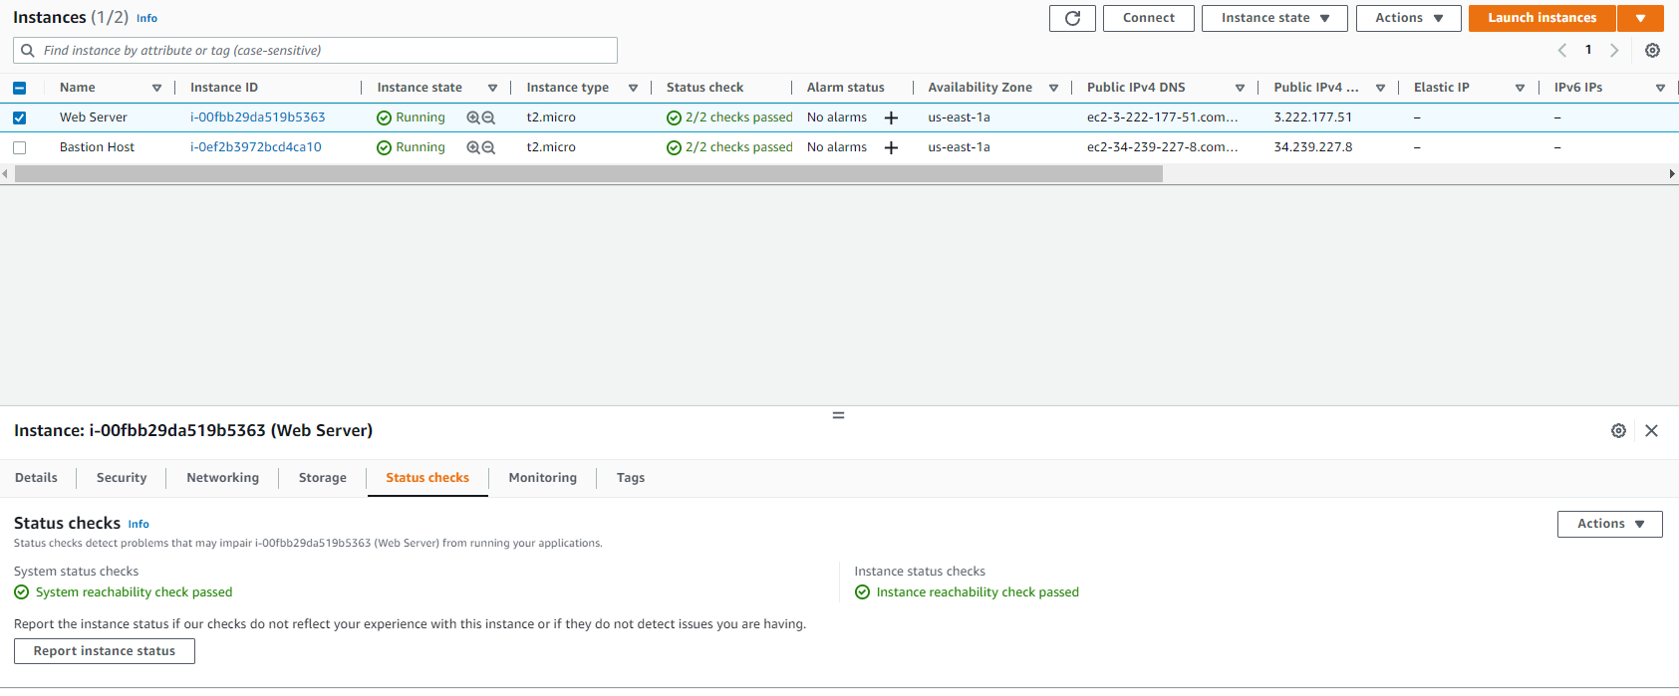
Choose web server and then click on status checks to verify health of ec2 instances

Slide 18
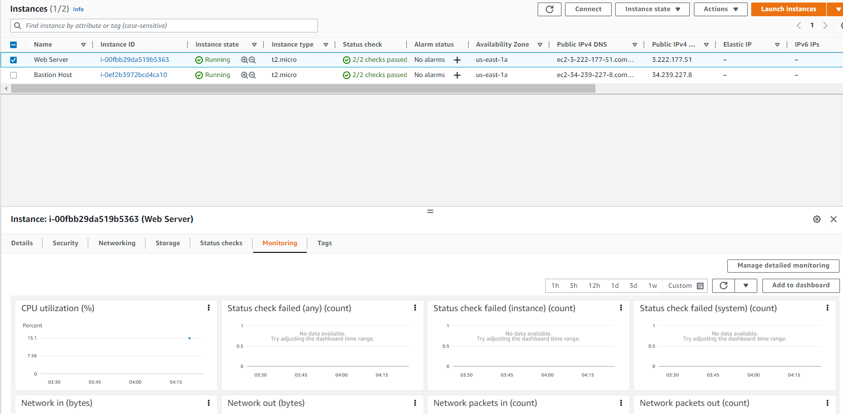
Choose the monitoring tab to view the history of various details, click on enlarge using the three dots to view in detail

Slide 19
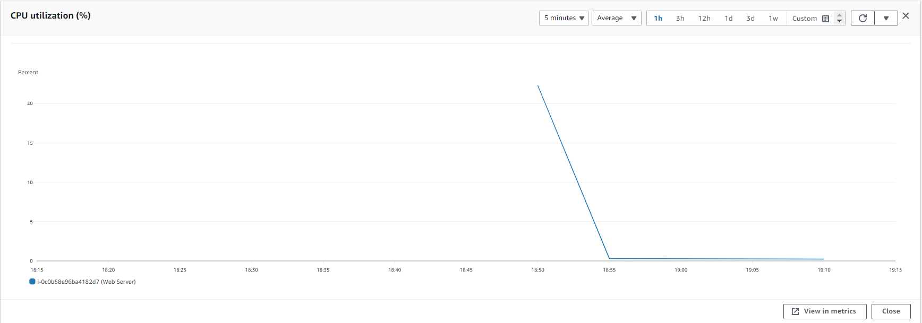
Enlarged view of cpu utilization

Slide 20
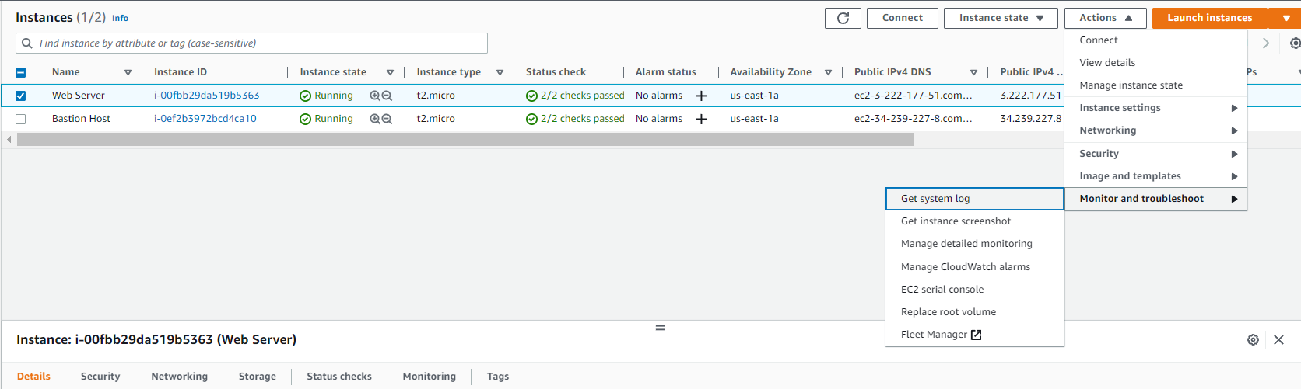
Select web server and then click on actions > monitor and troubleshoot > get system log
Click on Actions
Select monitor and troubleshoot
Select get system log

Slide 21
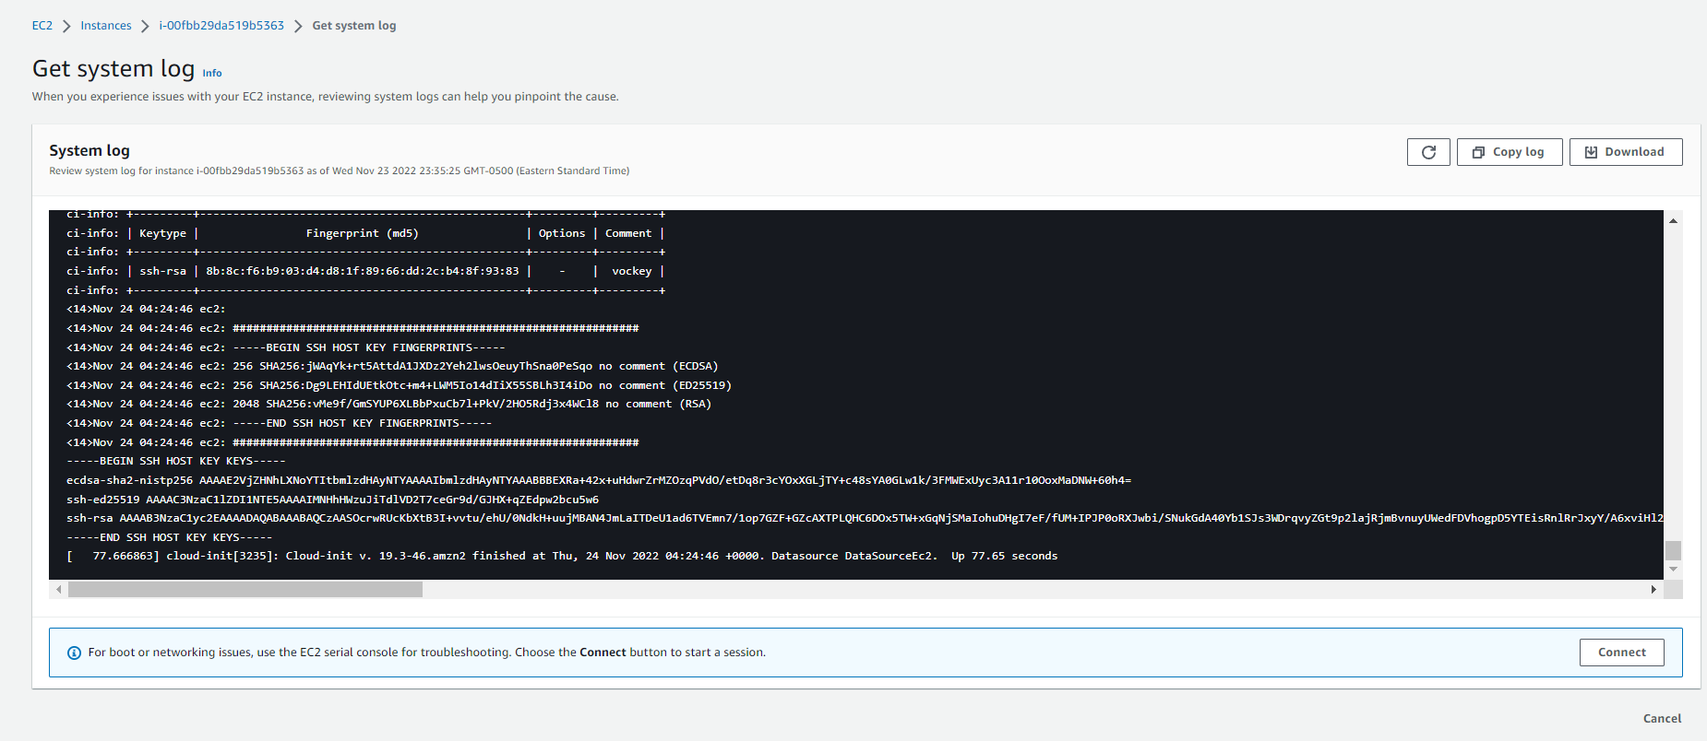
System log helps users in diagnosing issues In the ec2 instance, press cancel after exploring

Slide 22
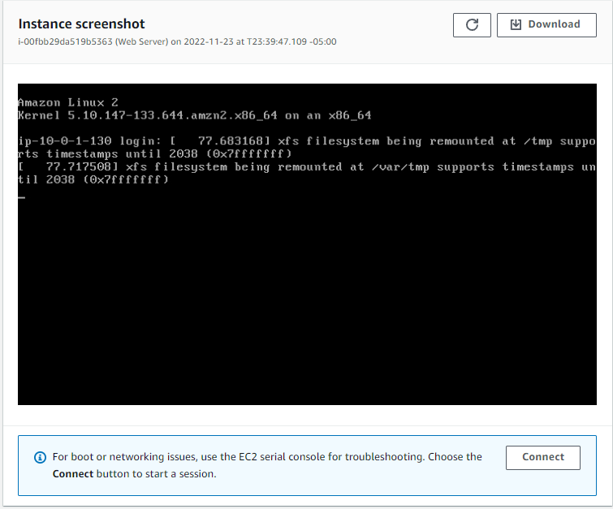
With web server still selected click actions > monitor and troubleshoot > get instance screenshot, click cancel once done

Slide 23
Task 3 : Update Your Security Group and Access the Web Server

Slide 24
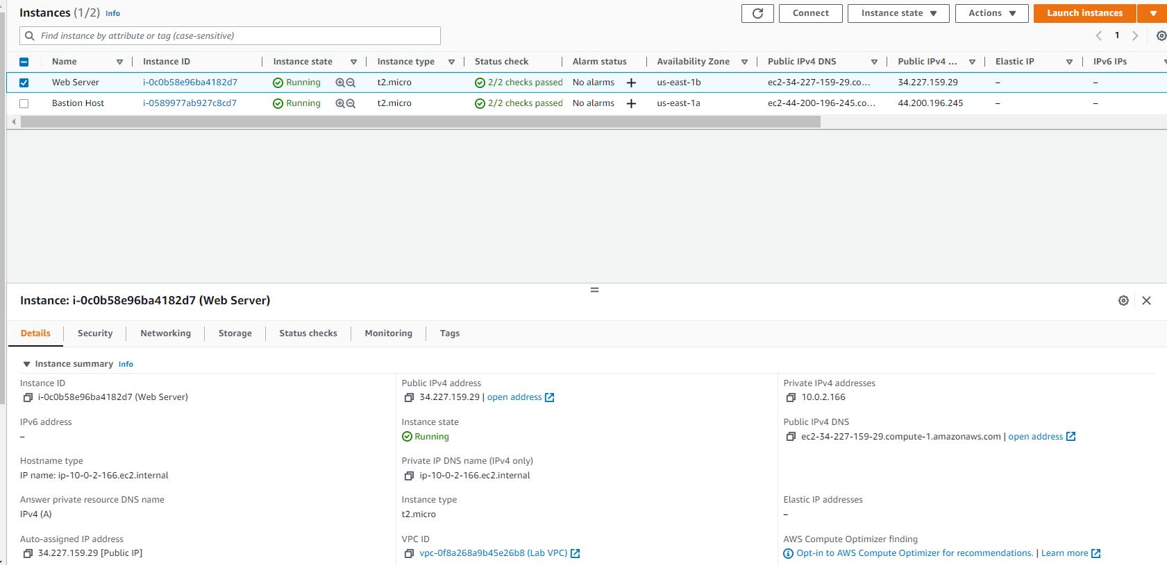
Copy the public ipv4 address for web server ec2 instance and paste it in browser

Slide 25
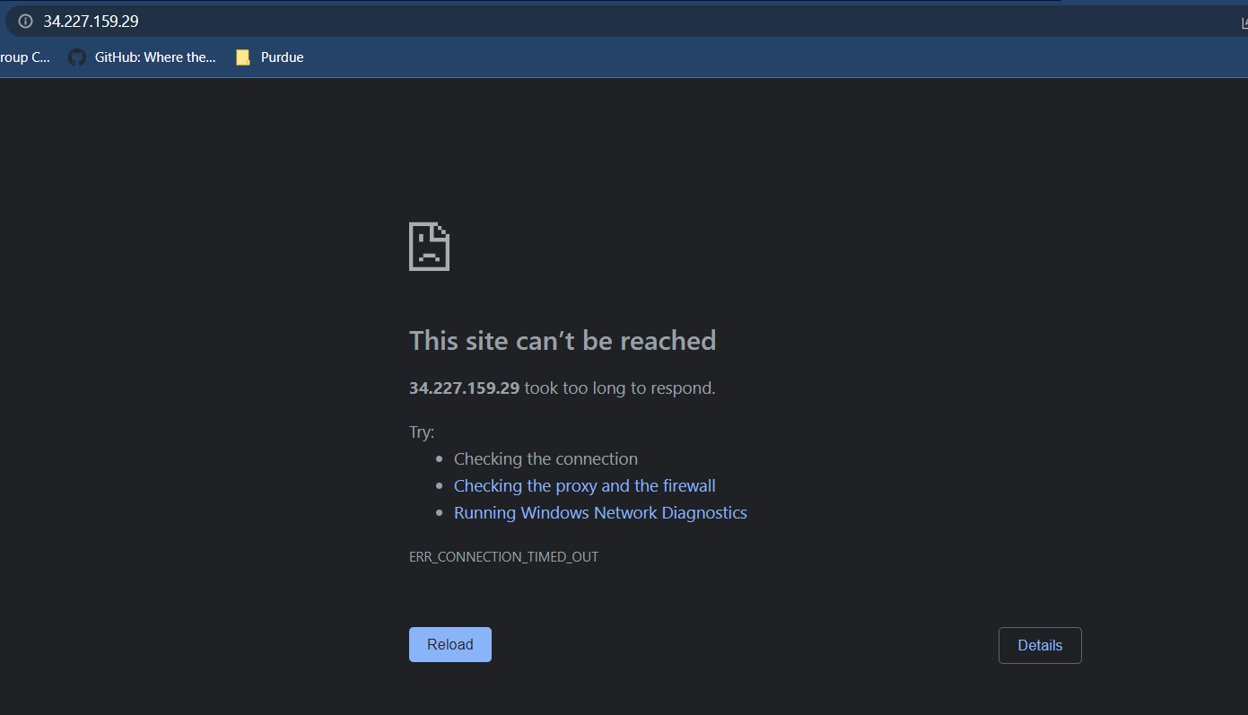
Unable to access the ip address

Slide 26
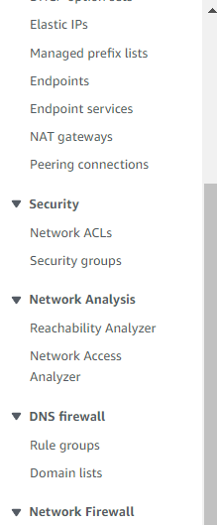
In navigation pane choose security groups
Choose security groups

Slide 27
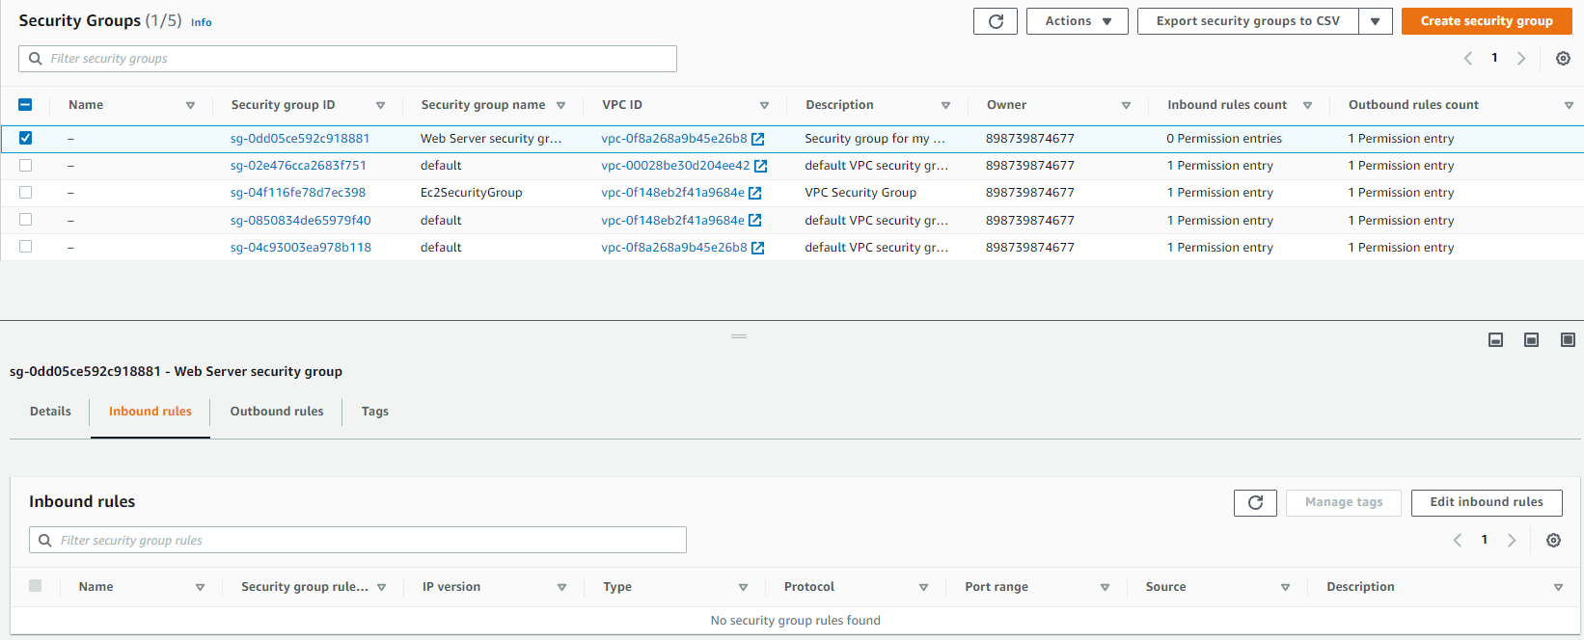
Select web server security group and toggle to inbound rules and click on edit inbound rules
Choose inbound rules
Click edit inbound rules

Slide 28
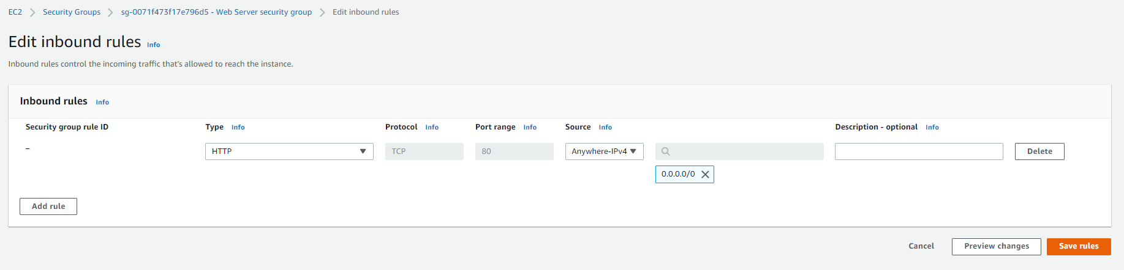
Create inbound rule using add rule and then hit save rule

Slide 29
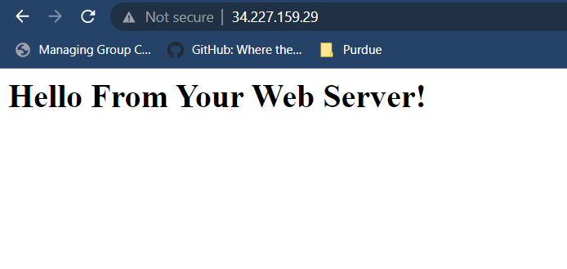
Refresh the webpage with the ipv4 address, web server is now accessible

Slide 30
Task 4 : Resize Your Instance: Instance Type and EBS Volume

Slide 31
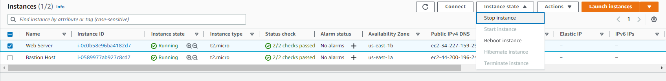
In the instance menu choose stop instance in instance state drop down
Click on instance state and then stop instance

Slide 32
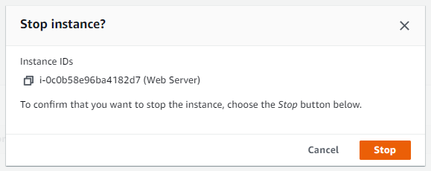
click on stop instance
Click on stop instance

Slide 33
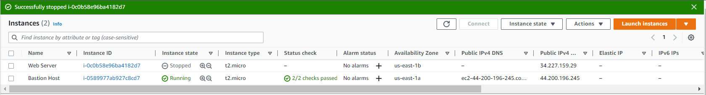
Wait for instance to stop

Slide 34
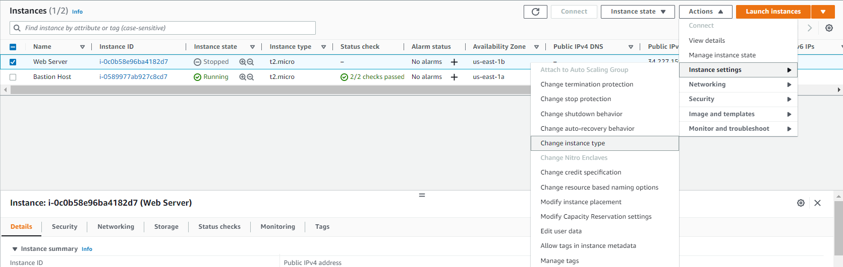
Change the instance type by selecting actions > instance settings > change instance type

Slide 35
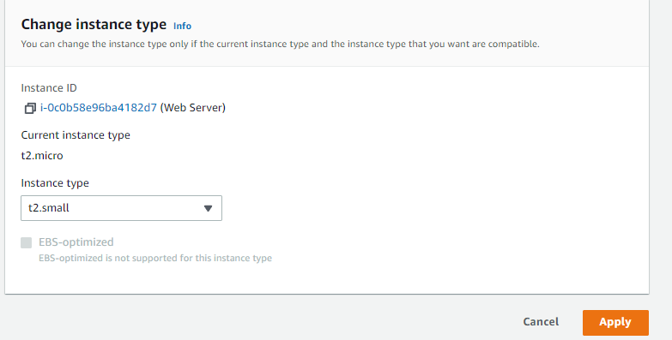
Change instance type to t2.small and hit apply

Slide 36
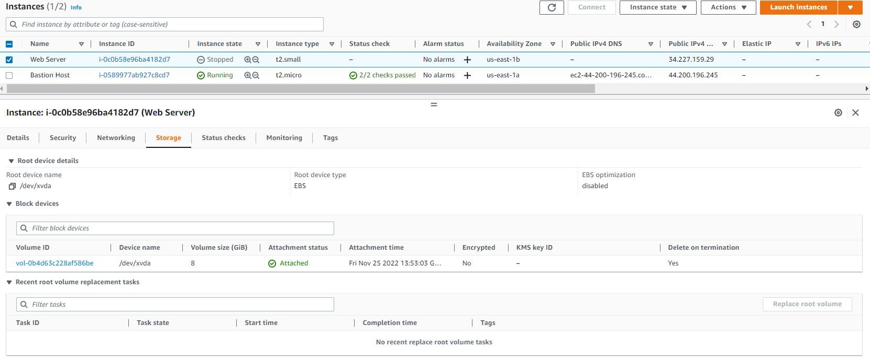
Select storage tab and then click on the volume id
Click on volume ID

Slide 37
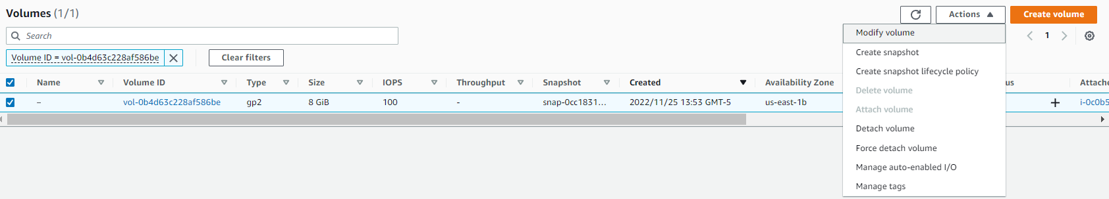
Choose the tick box and click on actions > modify volume

Slide 38
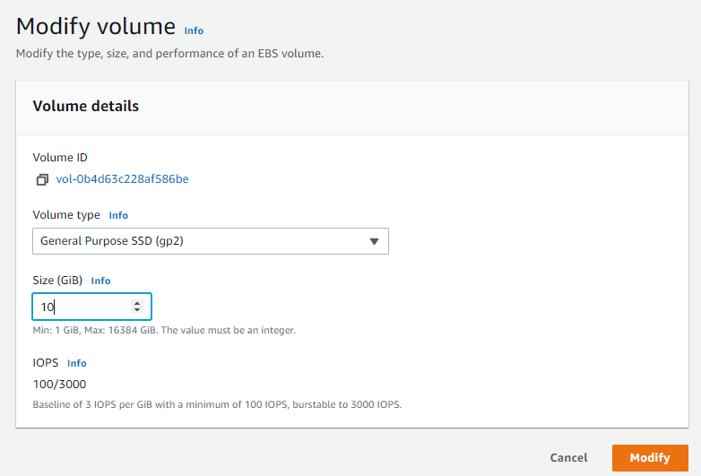
Modify volume to 10 gb and then press modify button

Slide 39
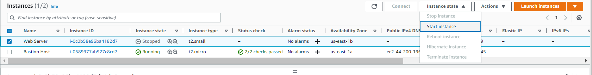
Start the resized instance from the instance menu by selecting instance state > start instance

Slide 40
Task 5: Explore EC2 Limits

Slide 41
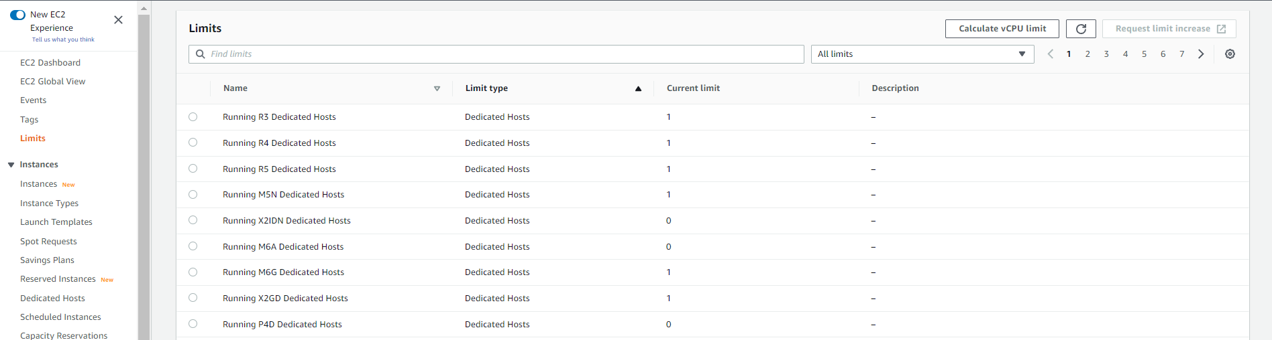
Click on limits in the navigation pane to open the limits dashboard

Slide 42
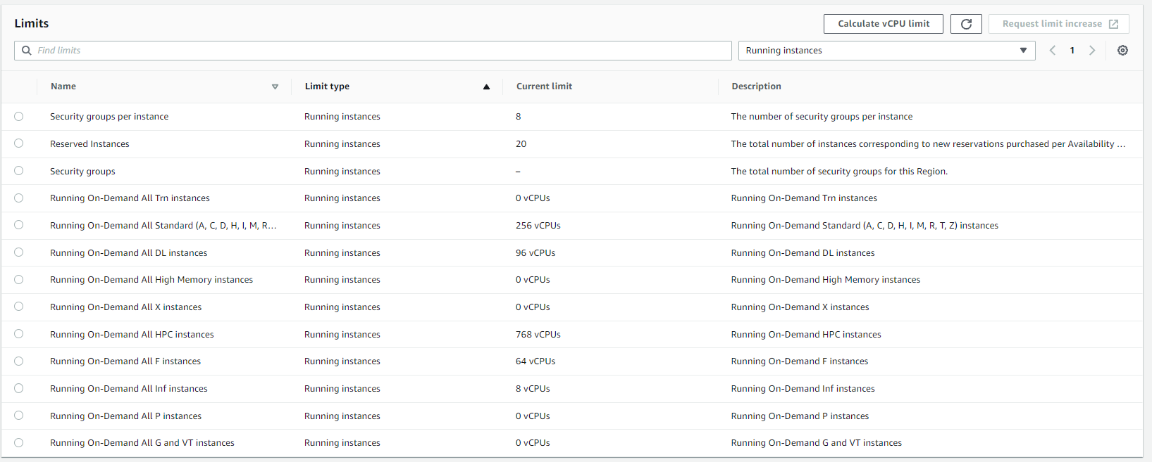
Choose running instances in the dropdown highlighted

Slide 43
Task 6: Test Termination Protection

Slide 44
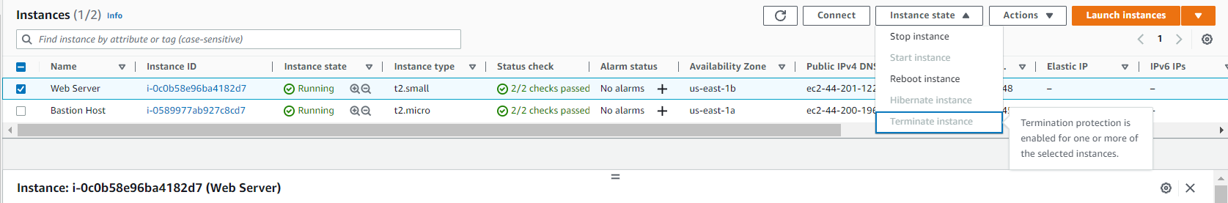
Next try to terminate instance in the instance menu, terminate instance is greyed out because termination protection is enabled

Slide 45
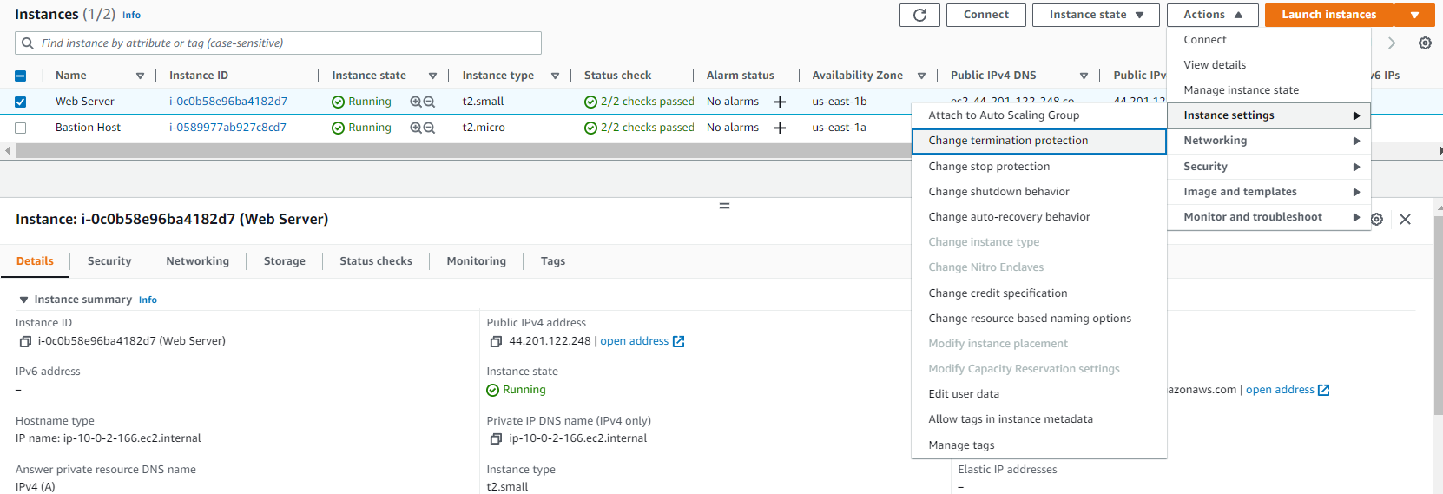
To resolve this issue, go to instance settings and hit change instance protection

Slide 46
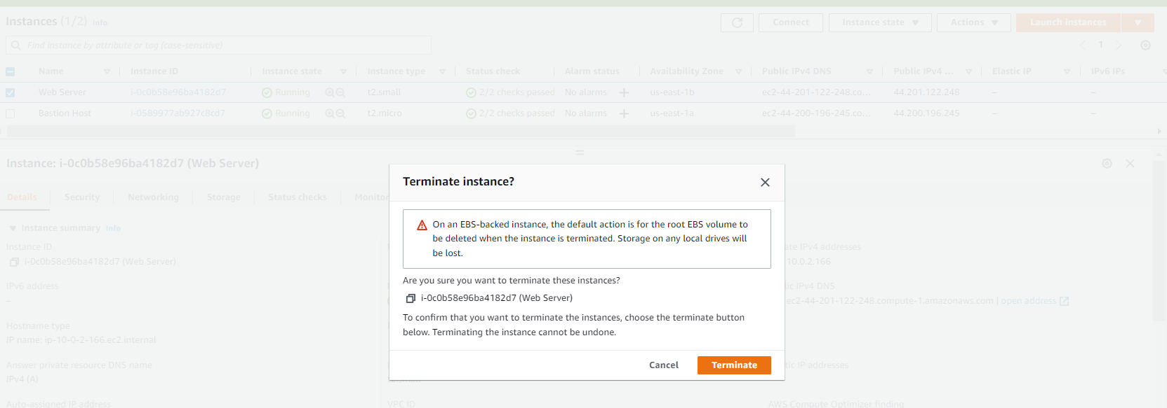
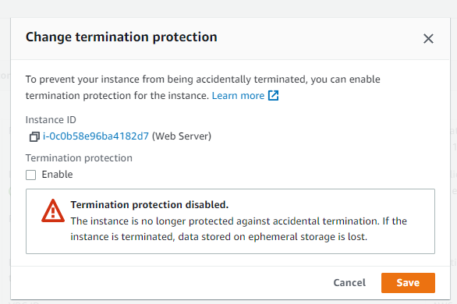
Uncheck termination protection and then save, try to terminate the instance now

Slide 47
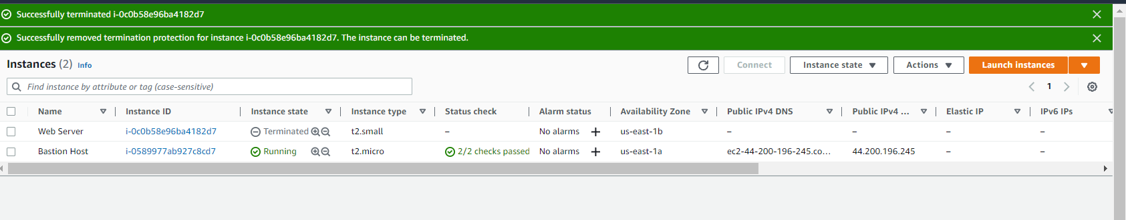
Click on terminate

Slide 48
Instance successfully terminated

Slide 49
THANK YOU
Amrit Singh

